Slide 1
Rails models intro
Adding a model to the cafe app

Slide 2
To prepare
Fork and clone the cafe app if you don’t have it already: https://github.com/CoderAcademy-BRI/cafe-rails-start
From the cafe directory:
rm Gemfile.lock && bundle install
Update the config/database.yml file with your postgres details (see slides for last lesson)
Run rails db:setup && rails db:migrate
Start the rails server with rails s

Slide 3
A model represents a resource in Rails
We use models to represent our data in the application, and in Rails these models represent the resources of our application
Our models will extend the ActiveRecord class by extending the ApplicationRecord class, which will allow us to access our database with ease from our model class. It turns the model class into an object relation mapping (ORM). An ORM is a framework that allows interacting with a database through methods in code.
Let’s create a MenuItem model to populate our menu for the cafe.

Slide 4
Generating a model
We can generate a model like we generate a controller - using rails generate model (or rails g model)
The syntax is:
rails g model <model name (singular pascal case)> <column_name:data_type{size}|{size,precision}> …
If there are multiple columns, specify in a space-separated list Specifying size and precision are optional Default data type is string

Slide 5
Try it! Generate the MenuItem model
rails g model MenuItem name:string{50} 'price:decimal{10,2}'
Note: 1. Specifying a max length of 50 characters for the name 2. Specifying decimal with max length 10 and precision 2 for price (this will give us 2 decimal places). We have to use quotes around the price because of the way generate interprets the comma inside of the curly braces.

Slide 6
Db Migration file
class CreateMenuItems < ActiveRecord::Migration[5.2]
def change
create_table :menu_items do |t|
t.string :name, limit: 50
t.decimal :price, precision: 10, scale: 2
t.timestamps
end
end
end

Slide 7
What happened?
The file app/models/menu_item.rb was created
The file db/migrate/<some date string>create_menu_items.rb was created
Some test files were created
The file in db/migrate is used when we run rails db:migrate to create the table - let’s have a look at it

Slide 8
Adding not null
We really want our name and price columns to be populated - to make them required fields
We can’t add this constraint with the generator, but we can update the migrate script to include it:
class CreateMenuItems < ActiveRecord::Migration[5.2]
def change
create_table :menu_items do |t|
t.string :name, limit: 50, null:false
t.decimal :price, precision: 10, scale: 2, null:false
t.timestamps
end
end
end

Slide 9
Try it! Run rails db:migrate
When you run rails db:migrate, it will create the table in development database
You can look at the database in pgadmin and see that now we have a table.
Side note: If you ever want to undo what is done with a migration, you can use rails db:rollback
-- create_table(:menu_items)
-> 0.0155s

Slide 10
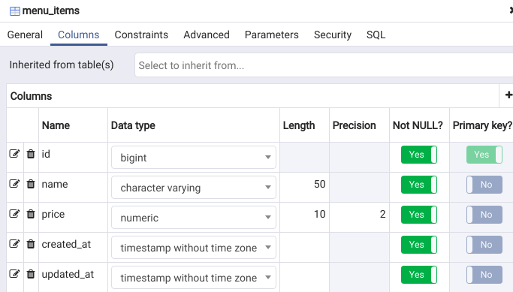
Created table
From pgadmin, under the cafe_development database-> schemas-> public-> tables, look at the properties of menu_items (on right-click menu). The columns tab shows the columns:
Notice it creates 3 extra columns - id, created_at, and updated_at

Slide 11
Rails console and rails dbconsole
We can access the rails console with the command:
rails console
or just
rails c
This is just IRB underneath. From here we can do a lot - for now, we will use it to look at the data in our database
The dbconsole is a shortcut to psql(when we’re using postgresql). You can run it with the command:
rails dbconsole

Slide 12
Try it!
Launch the rails console with rails c
We can use ActiveRecord methods to access our model
MenuItem.all will retrieve all rows from the menu_items table
$ rails c
Running via Spring preloader in process 16824
Loading development environment (Rails 5.2.3)
2.6.3 :001 > MenuItem.all
MenuItem Load (0.3ms) SELECT "menu_items".* FROM "menu_items" LIMIT $1 [["LIMIT", 11]]
=> #<ActiveRecord::Relation []>
2.6.3 :002 >
That’s not too exciting - we don’t have any records in the table yet

Slide 13
Populating data
Eventually we could add a way to add menu items via our app, but even still, it is handy to have a way to seed data for our application, to aid in development
There are a number of ways to do this:
INSERT from psql
INSERT from rails dbconsole
INSERT from pgadmin (or using edit data in the GUI)
MenuItem.create from rails console
But the easiest way is to add some code to the seeds.rb file in the db directory

Slide 14
Using the db/seeds.rb file
By populating data from this file, we can easily recreate the data whenever we want, and if someone pulls down our project, they can easily populate the seed data we use for development or for testing
We will use some ActiveRecord methods to accomplish this in our seeds.rb file

Slide 15
Try it! Add our latte, tea, and scone menu_items
# Create menu items
# Delete all existing items
MenuItem.destroy_all
# Create latte, tea, and scone
MenuItem.create(name:"latte", price: 4.00)
MenuItem.create(name: "tea", price: 3.00)
MenuItem.create(name: "scone", price: 5.00)
Add the following to db/seeds.rb:
destroy_all deletes all records in the menu_items table
create creates a new record(row) in the menu_items table
Note that using this method, we don’t have to specify the id, created_at, or updated_at. ActiveRecord takes care of that for us.
Run: rails db:seed

Slide 16
Try it! Check the table from rails console
>pp MenuItem.all
[#<MenuItem:0x00007fe4b445d238
id: 13,
name: "latte",
price: 0.4e1,
created_at: Wed, 05 Jun 2019 06:11:56 UTC +00:00,
updated_at: Wed, 05 Jun 2019 06:11:56 UTC +00:00>,
#<MenuItem:0x00007fe4b445d0f8
id: 14,
name: "tea",
price: 0.3e1,
created_at: Wed, 05 Jun 2019 06:11:56 UTC +00:00,
updated_at: Wed, 05 Jun 2019 06:11:56 UTC +00:00>,
#<MenuItem:0x00007fe4b445cfb8
id: 15,
name: "scone",
price: 0.5e1,
created_at: Wed, 05 Jun 2019 06:11:56 UTC +00:00,
updated_at: Wed, 05 Jun 2019 06:11:56 UTC +00:00>]
rails c
MenuItem.all should show the three records
It does … I think. It’s really messy!
There is a pretty print option in rails console. To use it, we just prefix the command with pp:
>pp MenuItem.all

Slide 17
Try it! Some other active record commands
Try these:
MenuItem.first ← returns the first row of menu_items
item = MenuItem.where(name:”scone”).first ← where returns an array, so use first to get the record itself
item.name=”muffin” ← set the name of the retrieved record to “muffin”
item.save ← save the updated record to the database
MenuItem.all ← see that we actually changed the record in the database
Can you change “muffin” back to “scone”?

Slide 18
Retrieve the menu data from the model
class CafeController < ApplicationController
class MenuItem
attr_reader :name,:price
def initialize(name,price)
@name=name
@price=price
end
end
def index
@menu = [
MenuItem.new("latte",4.00),
MenuItem.new("tea",3.00),
MenuItem.new("scone",5.00)
]
end
end
Remember that currently the controller is hard coding the menu data and passing it to the view, using it’s only makeshift model class to represent the data.
Let’s change this to get the data from the model instead

Slide 19
Try it! Use MenuItem.all to retrieve the data
In the index action, we can just call MenuItem.all to get the data we want. It will be returned just as it is in the Rails console, as an array with all of the column data stored in the database table
We will no longer need our MenuItem implementation in the controller
class CafeController < ApplicationController
def index
@menu = MenuItem.all
end
end

Slide 20
Resources
Rails Guides Models
Advanced model generators
RoR Guides - command line
Rails console tips and tricks

